Slide 1
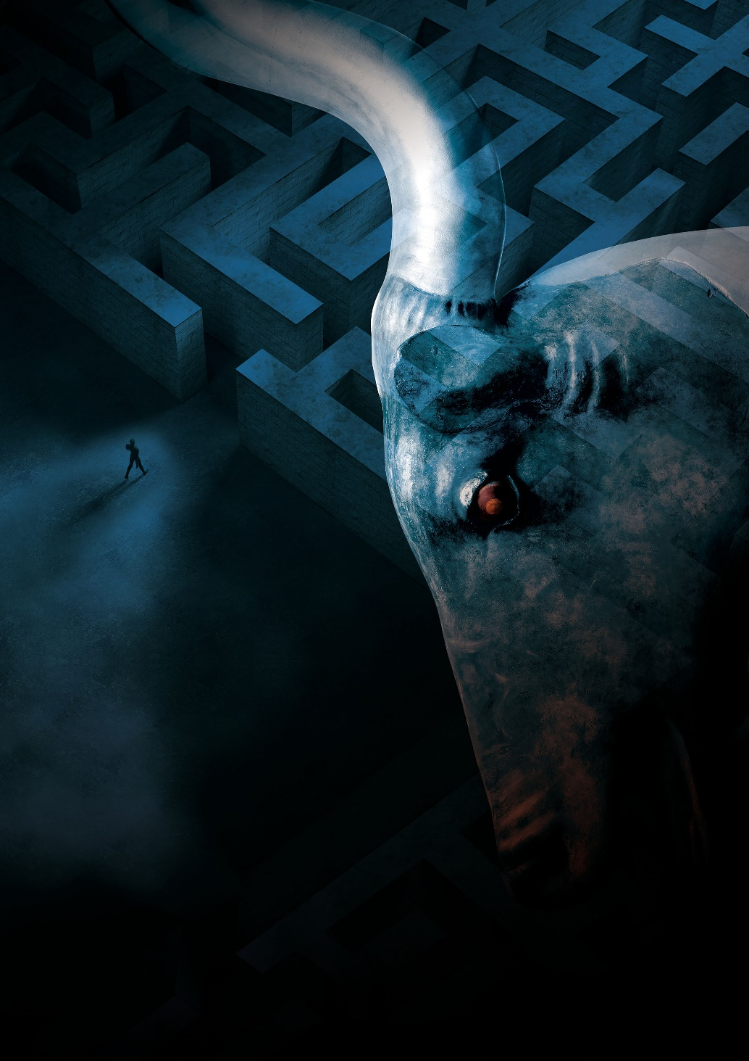
Creating a resource using Quire

Slide 2
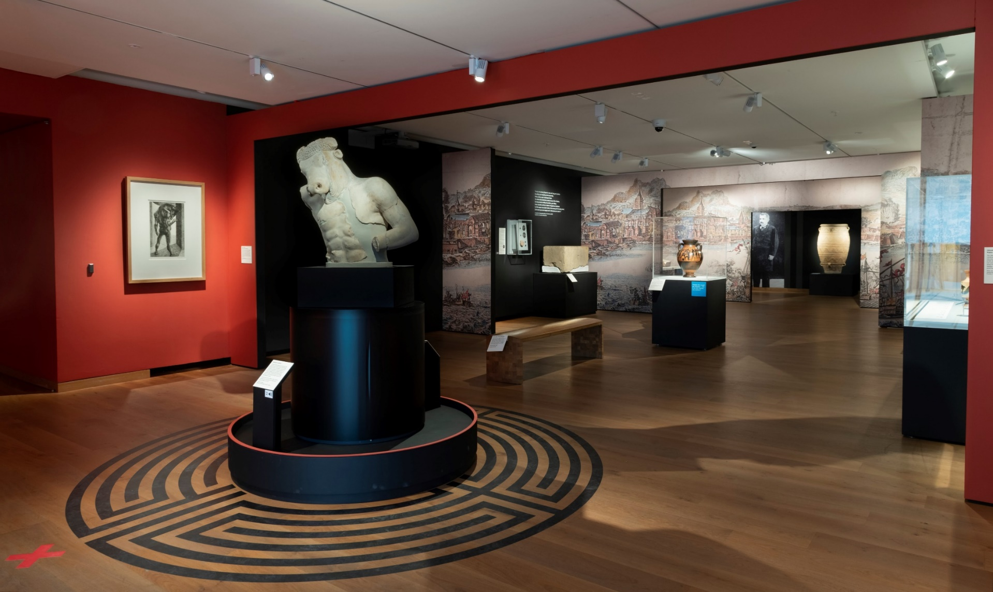
Labyrinth: Knossos, Myth & Reality
Ran February-July 2023
62k visitors
238 objects exhibited, of which 100 from Ashmolean collection (27 of which on permanent display)
© Ashmolean Museum, University of Oxford
CREATING A RESOURCE IN QUIRE

Slide 3
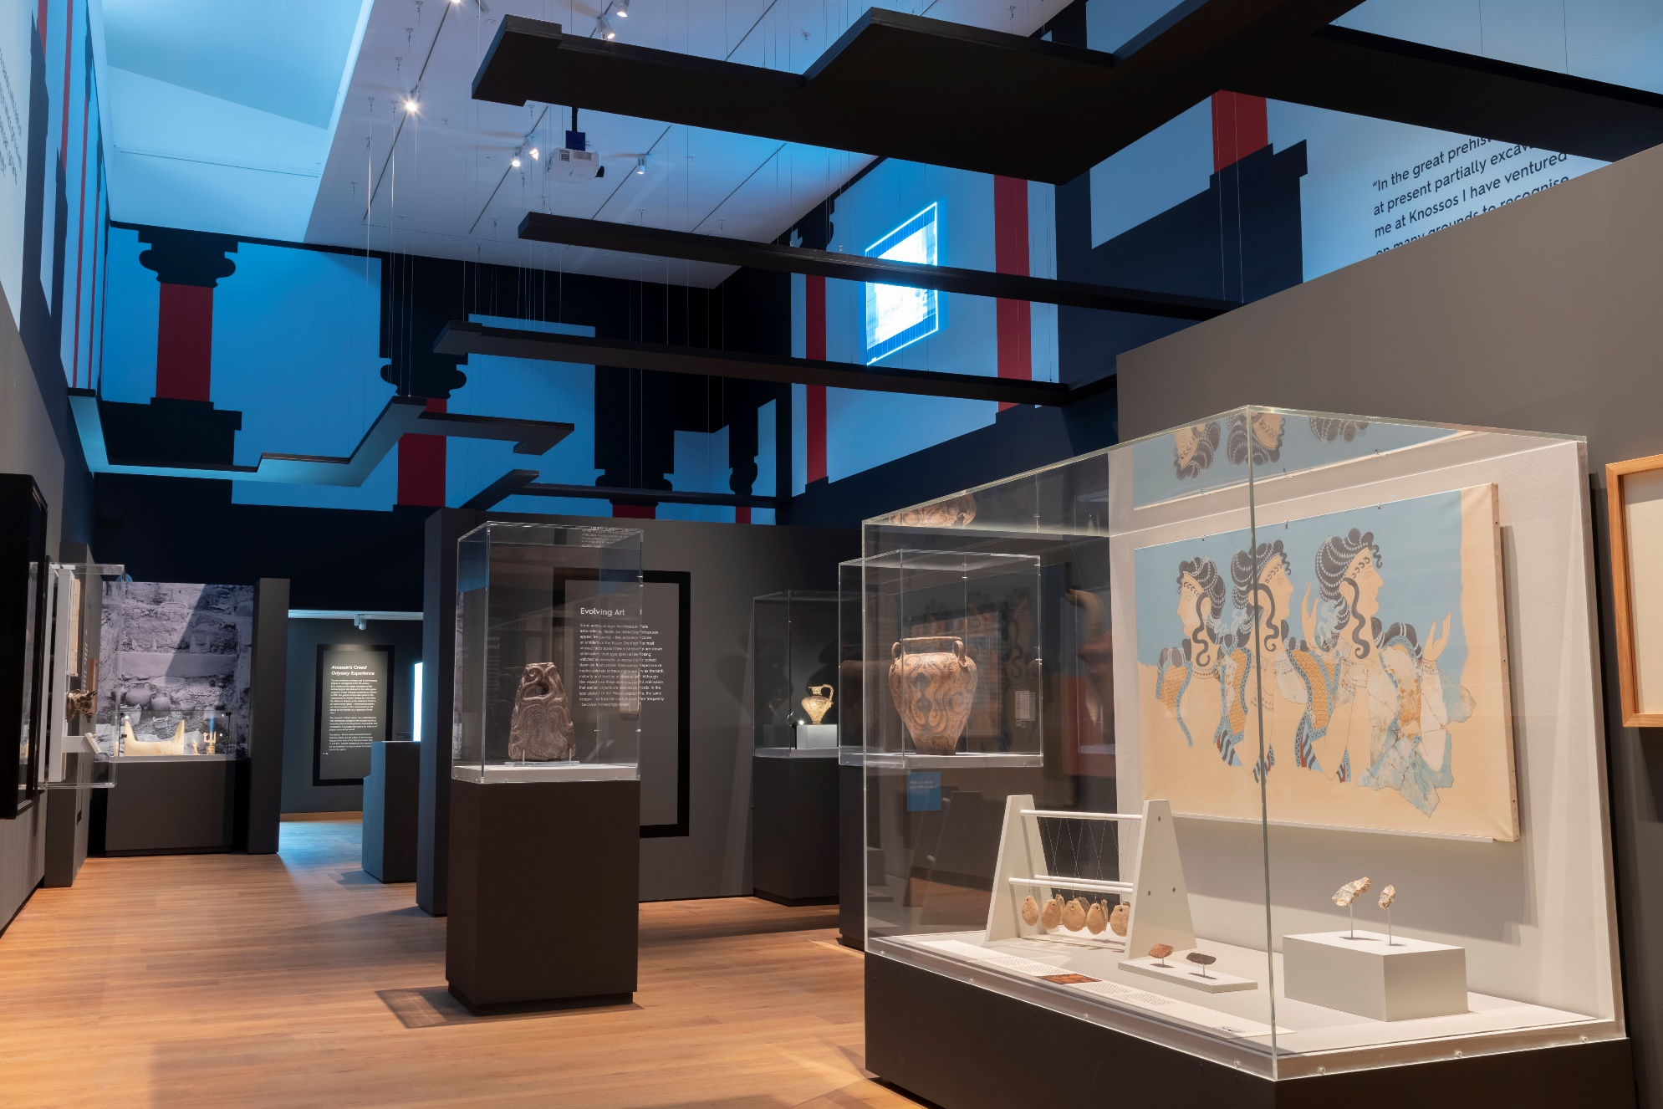
2023 Exhibition
Ashmolean has the archive for Sir Arthur Evans’s excavations at the site (1900-1931)
Finds now in Heraklion Museum shown alongside archive
Evans suggested that he had discovered the mythical Labyrinth
© Ashmolean Museum, University of Oxford
CREATING A RESOURCE IN QUIRE

Slide 4
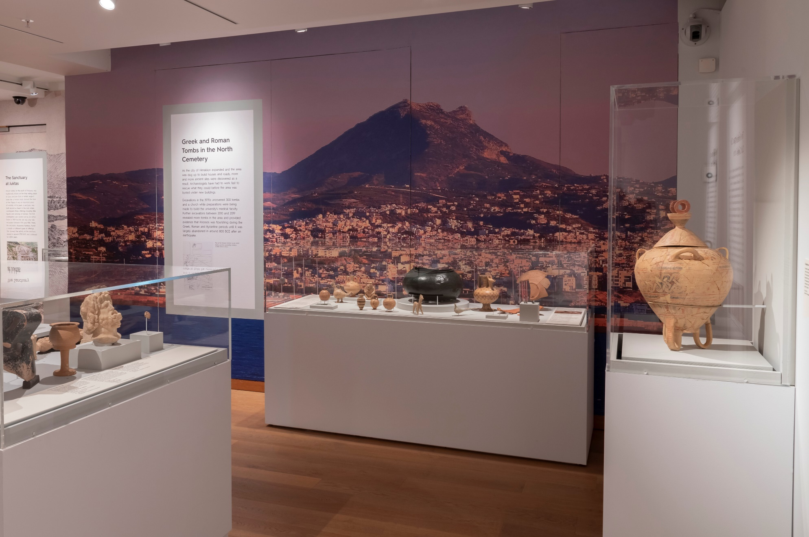
2023 Exhibition
More recent finds in Knossos valley also on display
Mostly loan objects – less connection with Ashmolean collection
© Ashmolean Museum, University of Oxford
CREATING A RESOURCE IN QUIRE

Slide 5
Recycling content
The exhibition generated lots of content which can be reused:
Catalogue
© Ashmolean Museum, University of Oxford
CREATING A RESOURCE IN QUIRE

Slide 6
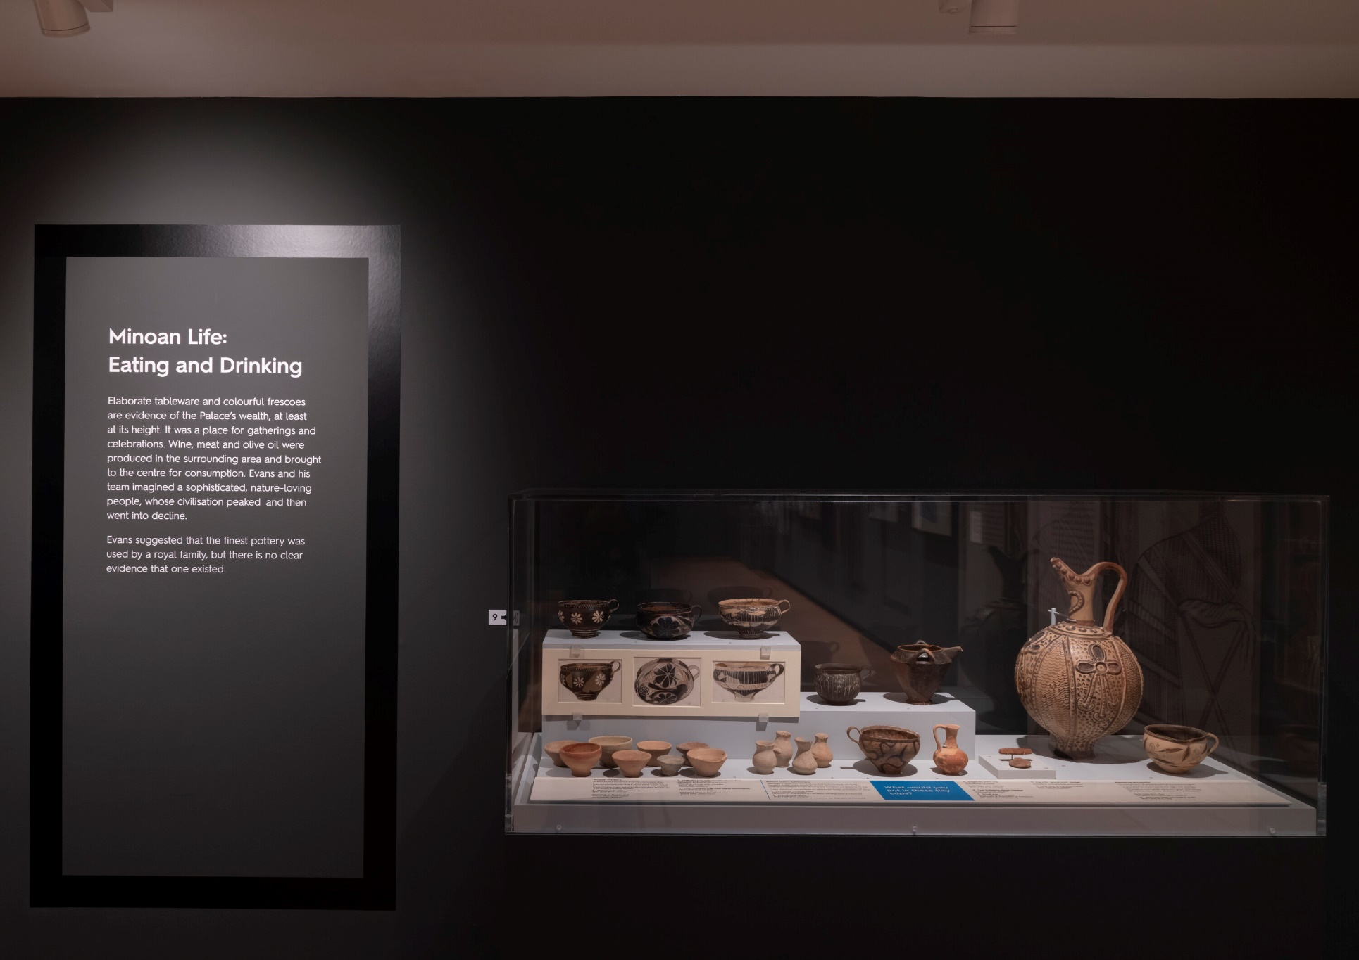
Recycling content
The exhibition generated lots of content which can be reused:
Catalogue
Exhibition panels/labels
© Ashmolean Museum, University of Oxford
CREATING A RESOURCE IN QUIRE

Slide 7
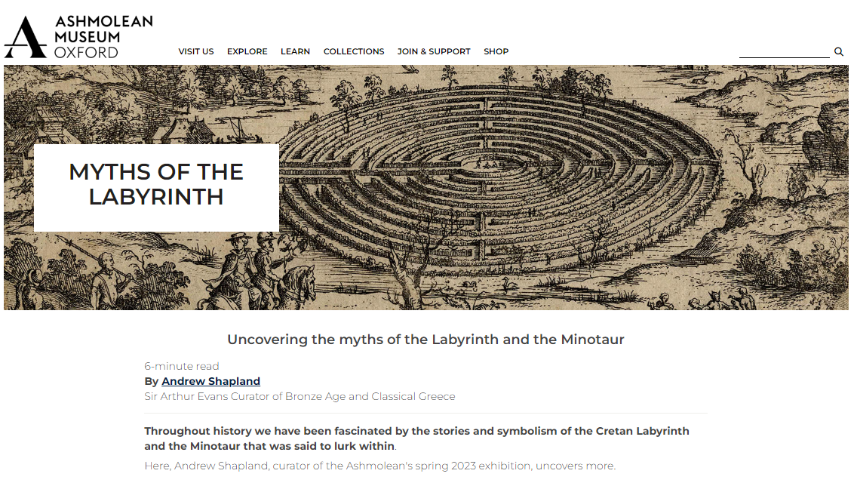
Recycling content
The exhibition generated lots of content which can be reused:
Catalogue
Exhibition panels/labels
Website
© Ashmolean Museum, University of Oxford
CREATING A RESOURCE IN QUIRE

Slide 8
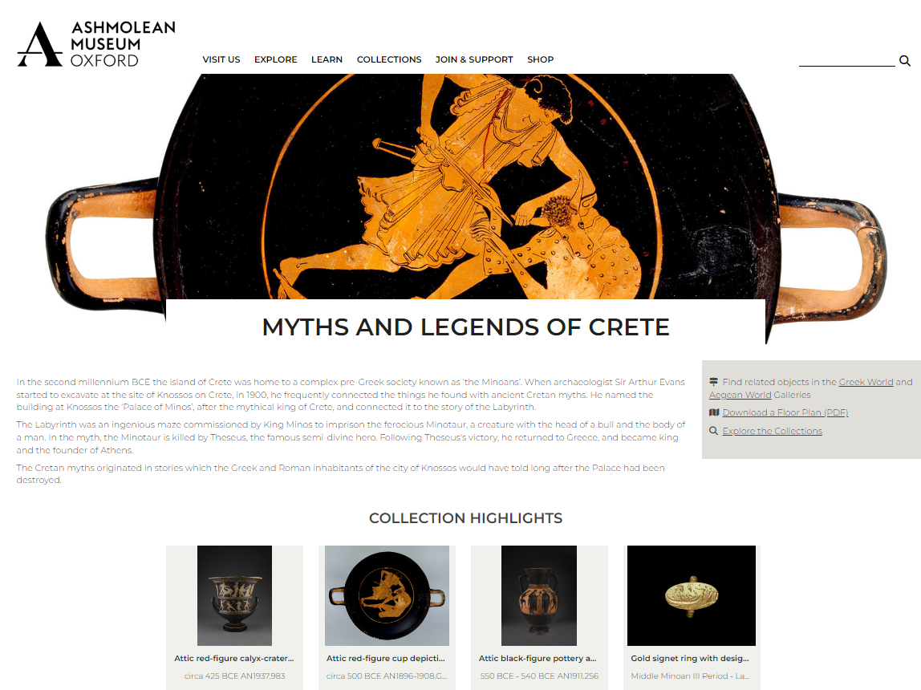
Recycling content
The exhibition generated lots of content which can be reused:
Catalogue
Exhibition panels/labels
Website
Enriched collection records
© Ashmolean Museum, University of Oxford
CREATING A RESOURCE IN QUIRE

Slide 9
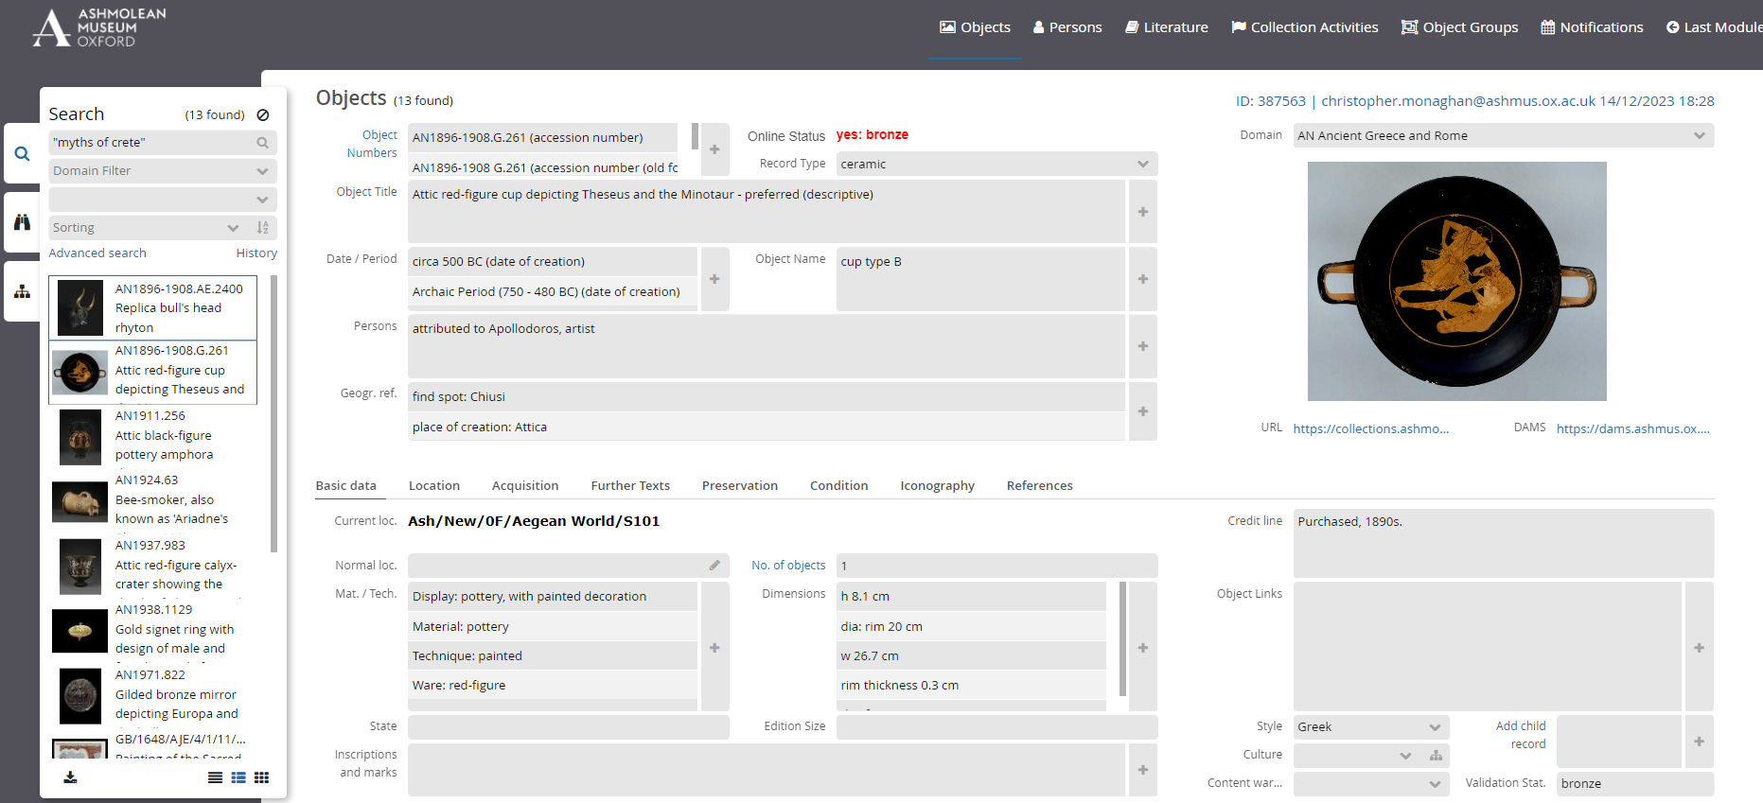
Collections records
Content gathered in Collection Management System (MuseumPlus)
© Ashmolean Museum, University of Oxford
CREATING A RESOURCE IN QUIRE

Slide 10
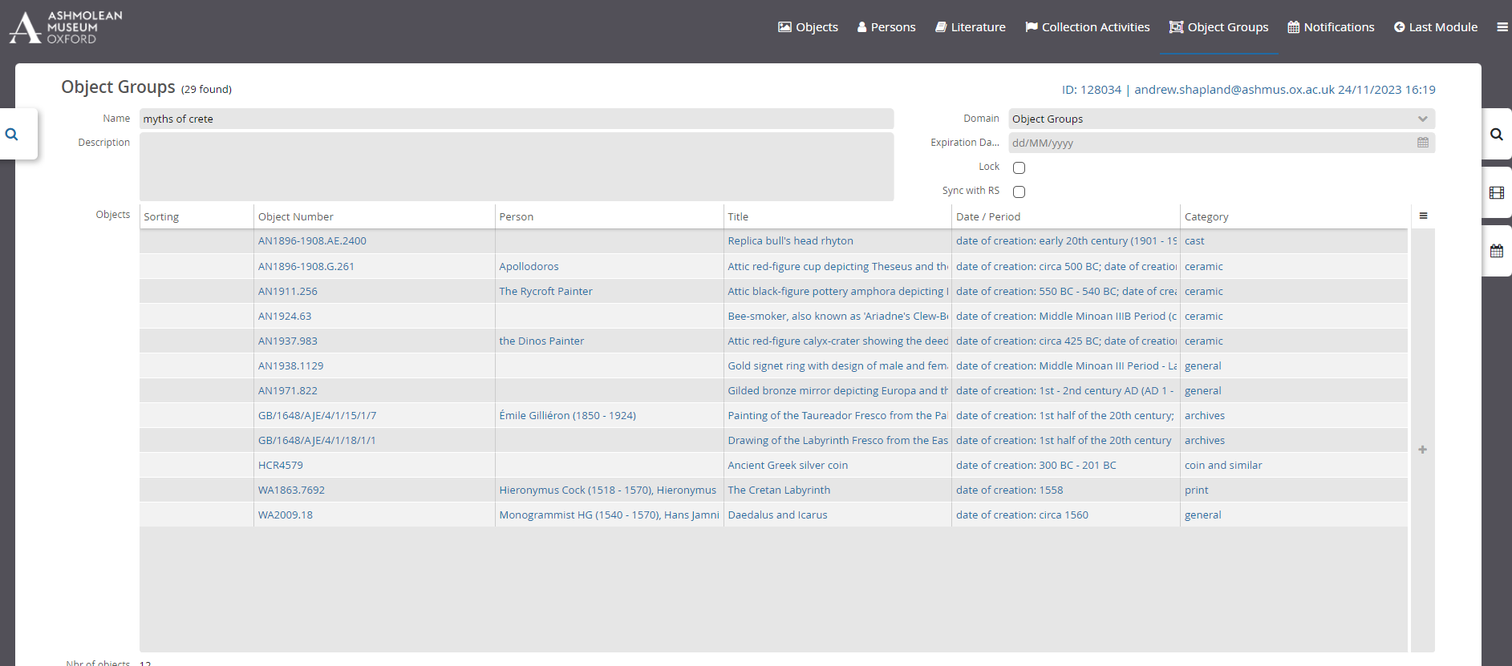
MuseumPlus
Sets of objects generated for use in different contexts
© Ashmolean Museum, University of Oxford
CREATING A RESOURCE IN QUIRE

Slide 11
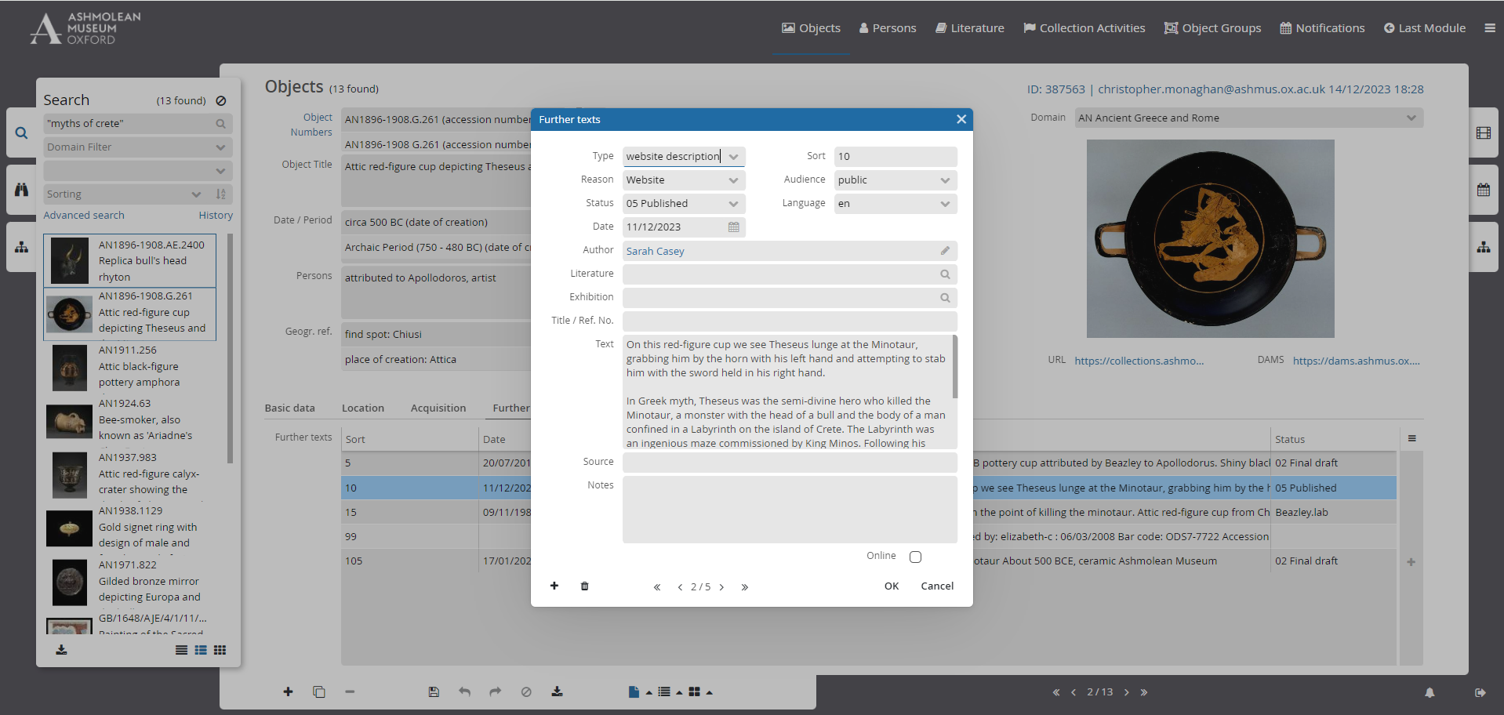
MuseumPlus
Content includes detailed descriptions for various purposes
© Ashmolean Museum, University of Oxford
CREATING A RESOURCE IN QUIRE

Slide 12
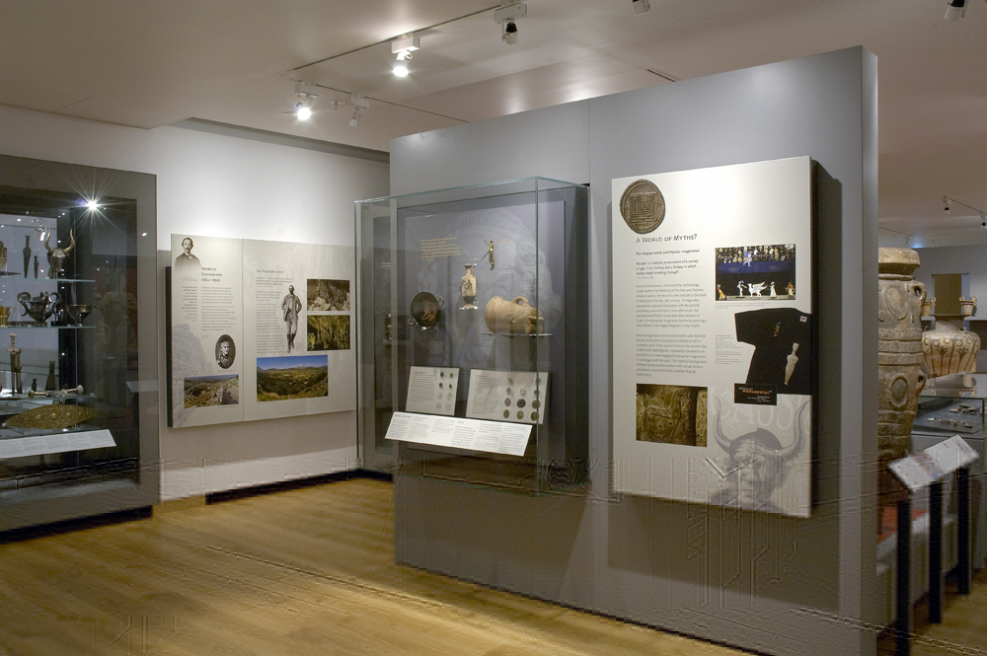
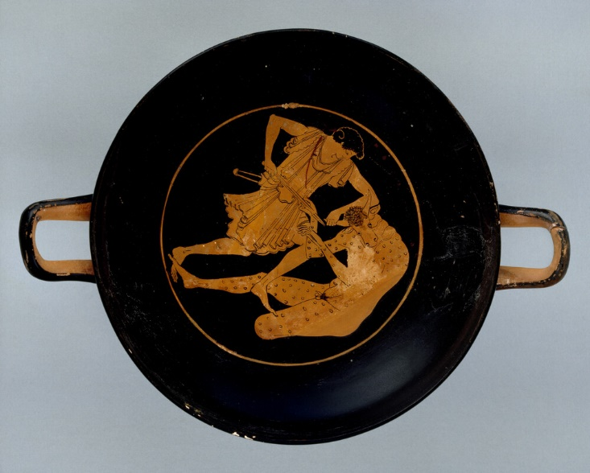
Aegean World Gallery
This content is most relevant to the permanent Aegean World gallery which contains a large number of objects from/related to Knossos
© Ashmolean Museum, University of Oxford
Attic red-figure cup depicting Theseus and the Minotaur , c. 500 BC. Ashmolean AN1896-1908.G.261
CREATING A RESOURCE IN QUIRE

Slide 13
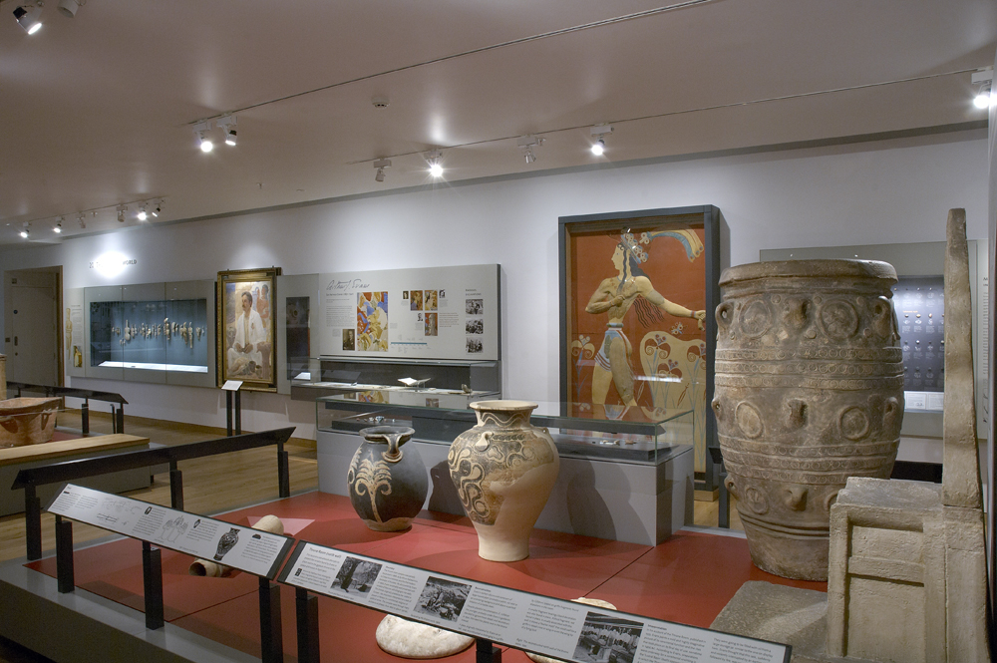
Aegean World Gallery
Largest collection of Minoan objects outside Greece, largely as a result of Sir Arthur Evans’s work at Knossos
© Ashmolean Museum, University of Oxford
CREATING A RESOURCE IN QUIRE

Slide 14
Educational Resources
Existing learning resources for teachers show there is interest in object-focussed teaching in gallery.
© Ashmolean Museum, University of Oxford
CREATING A RESOURCE IN QUIRE

Slide 15
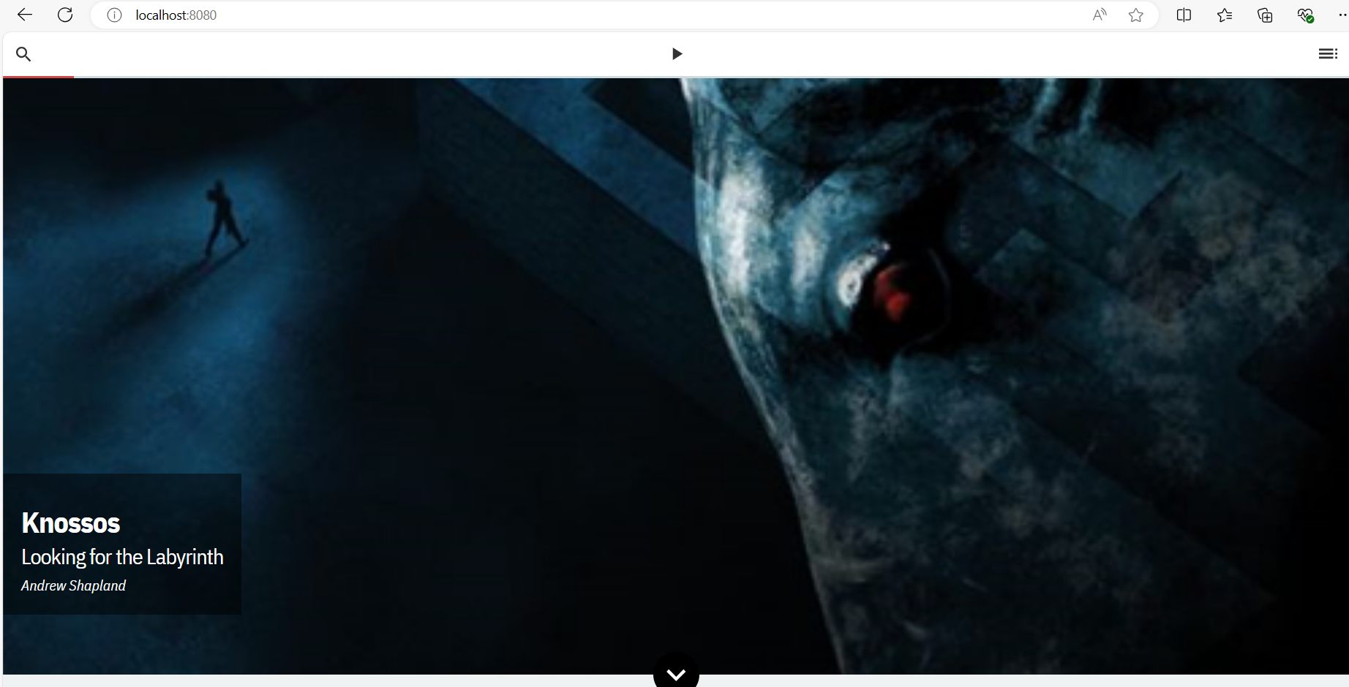
Quire resource
CREATING A RESOURCE IN QUIRE

Slide 16
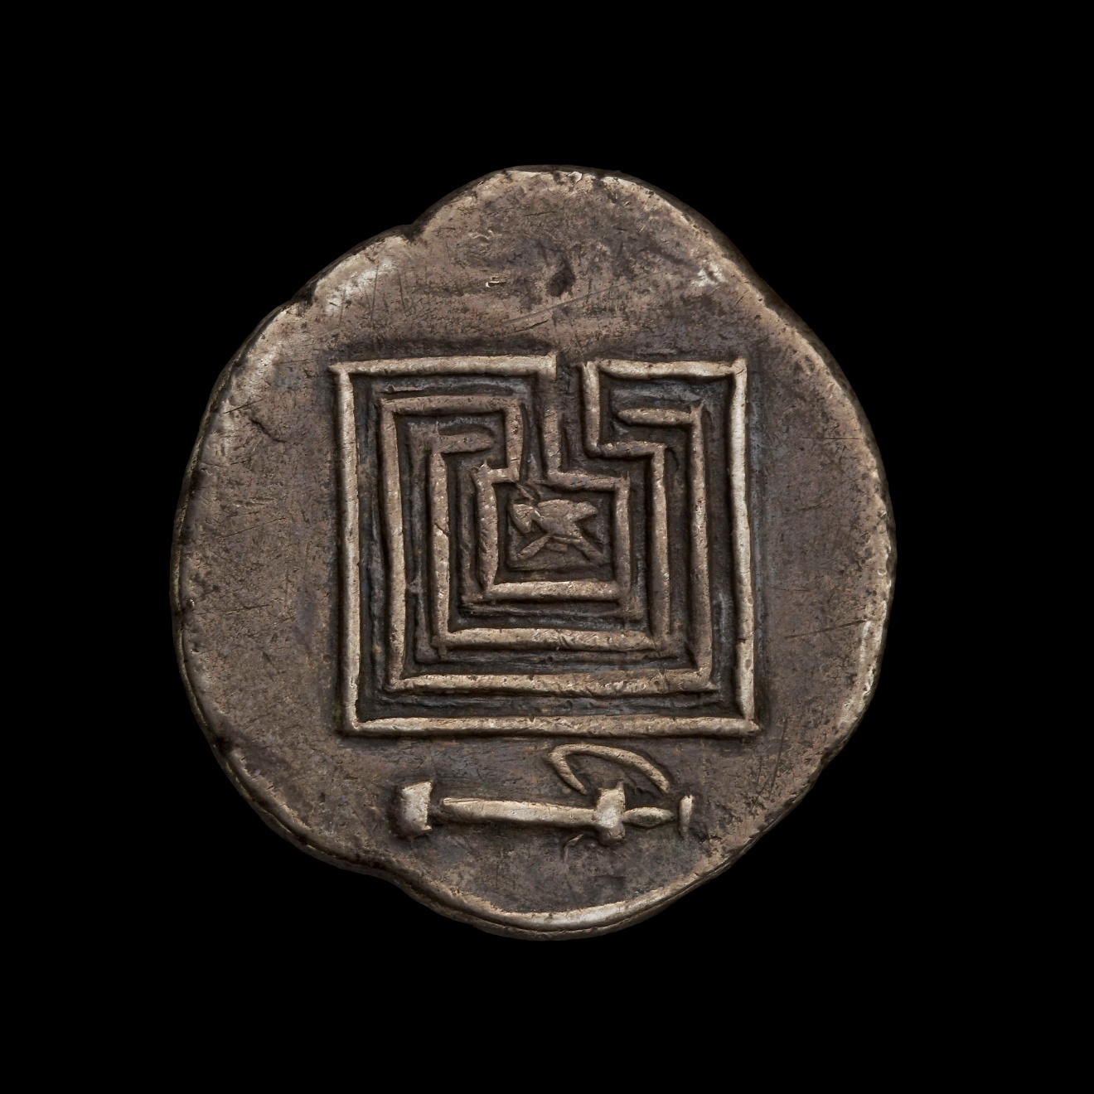
Quire
Don’t have to be a coder to use – YAML is intuitive
Quire website has helpful user guides but I preferred to play with (and sometimes break) the demo version by replacing content
Templates produce impressive results
Output is intended to be a publication (web or PDF) about objects
© Ashmolean Museum, University of Oxford
CREATING A RESOURCE IN QUIRE

